Slide 1
CLASSROOM RULES
Be on time
Be interactive
100% or nothing
Do all daily challenges

Slide 2
REVIEW

Slide 3
GRAMMAR + VOCABULARY

Slide 4
LISTENING
What do you want to do this weekend?
Would you like to go to a movie on Friday night?
What movie do you want to see?
There’s a good movie on TV tonight. Do you want to come over and watch it with me?
I have to meet my sister for dinner.
Let's go for coffee after class on Monday.
I have to go downtown. I have an appointment.
I’m not doing anything special.

Slide 5
SPEAKING
1. What do you often do in your free time?
2. What do your family members often do in their free time?
3. When you have friends round, what do you like to do?
4. Do you like reading books? What do you like to read most?
5. How often do you chat to your friends online?
6. Do you like listening to music? What kinds of music do you often listen to?
7. Do you often play games? What is your favorite computer game?

Slide 6
Lesson 13
VERBS & TENSES 2
Brought to you by LangGo

Slide 7
OBJECTIVES
01
02
03
Past simple tense
Past continuous tense
Practice

Slide 8
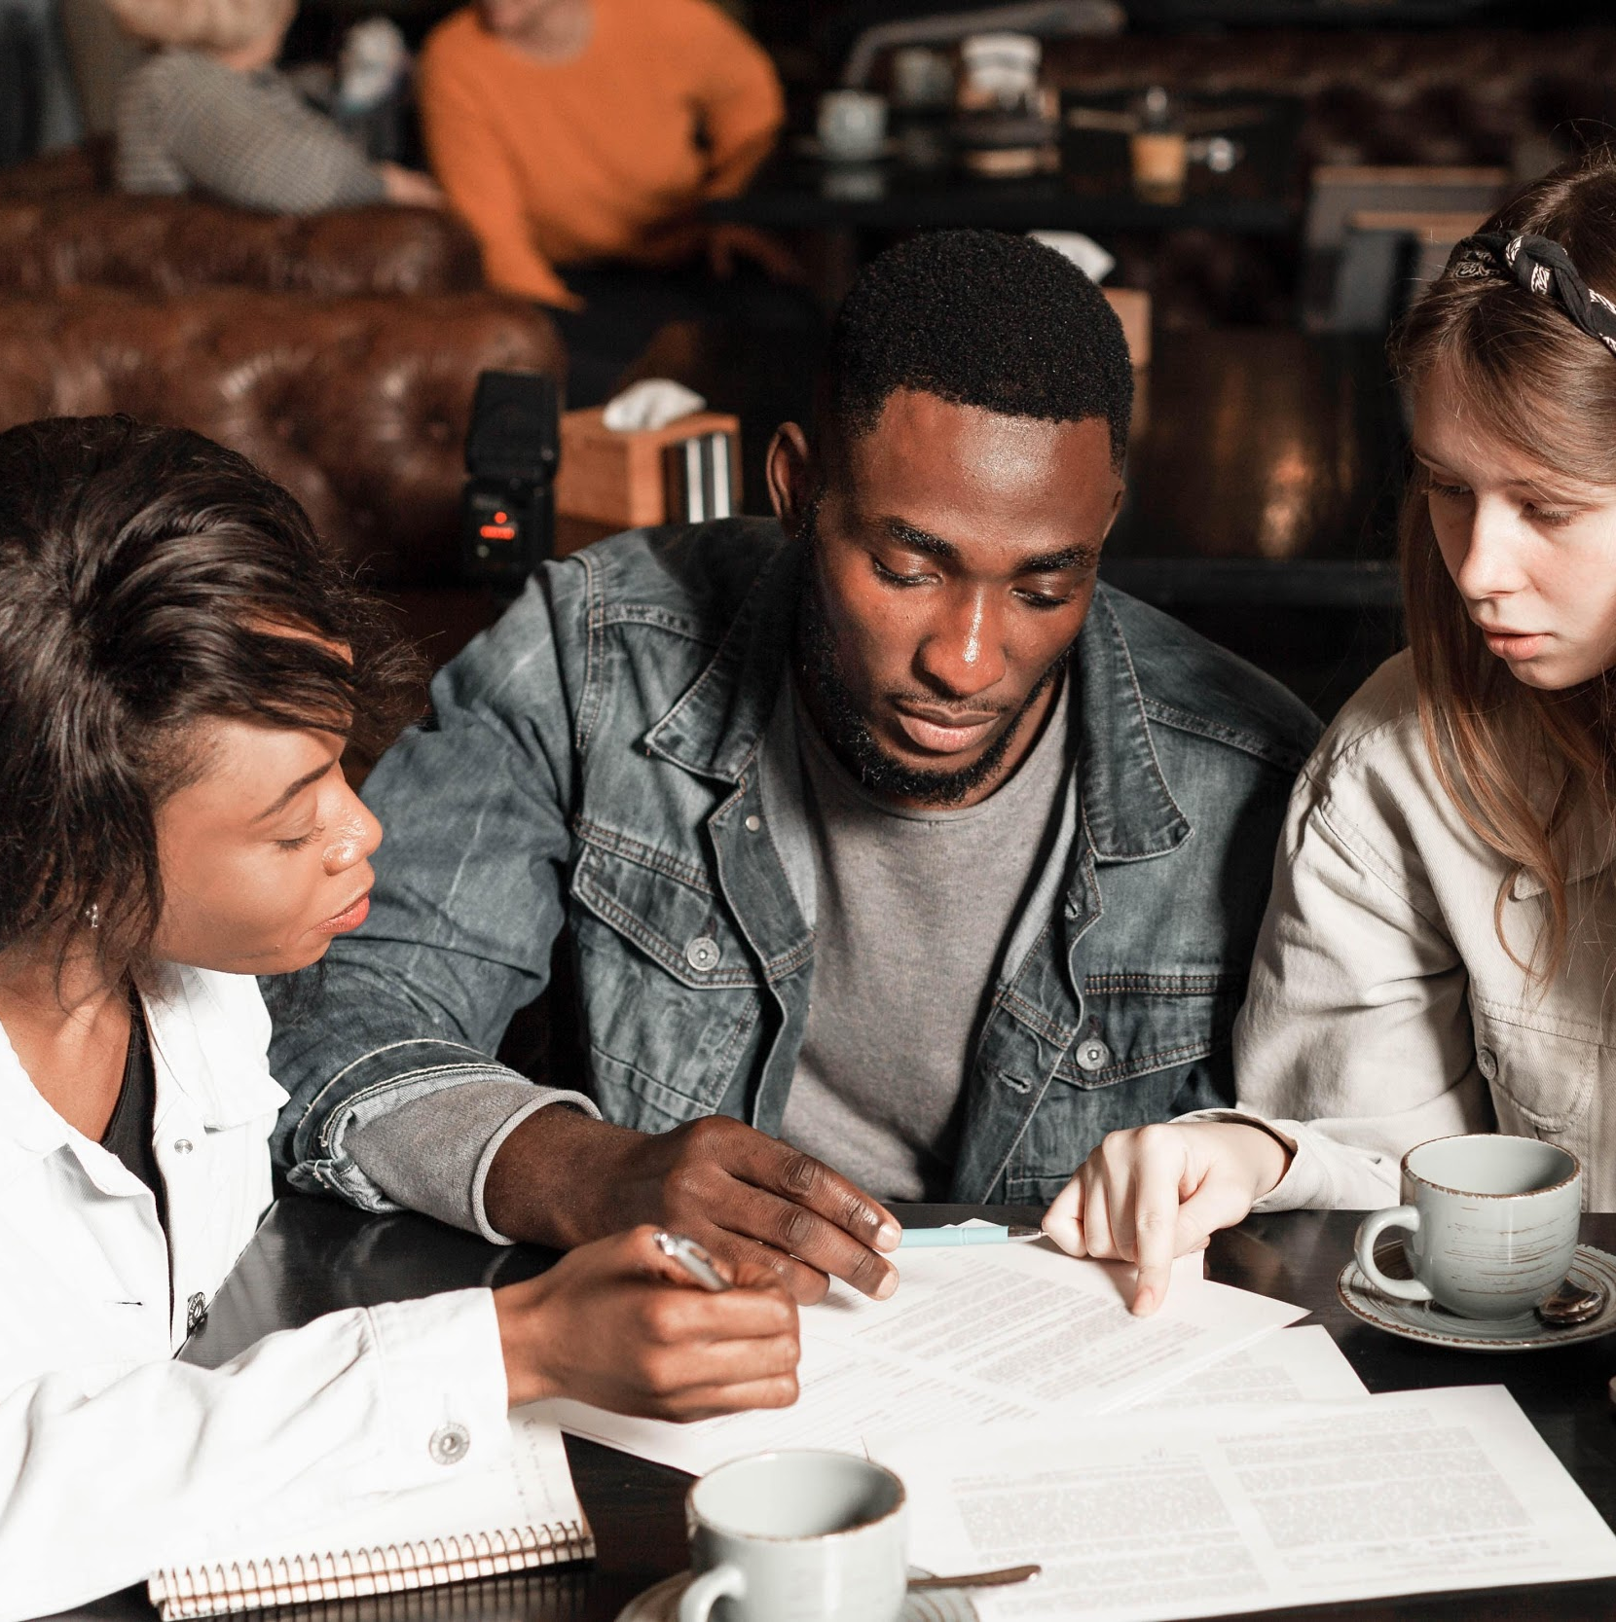
GRAMMAR
Past simple tense
Past continuous tense

Slide 9
PAST SIMPLE
USAGE
EXAMPLE
To express completed action in the past
I went camping with my friends last Friday.
To describe a series of completed actions in the past
We arrived at the airport, caught a taxi and went to a restaurant in the city centre.
To express habits in the past
When I was young, I travelled with my family every summer holiday.

Slide 10


PAST SIMPLE
TO BE
VERB
S + was/were + N/adj
S + V-ed +O
－
S + was/were + not + N/adj
S + did + not + V (infinitive) +O
Was/Were + S + N/adj?
Did + S + V (infinitive) +O?

Slide 11
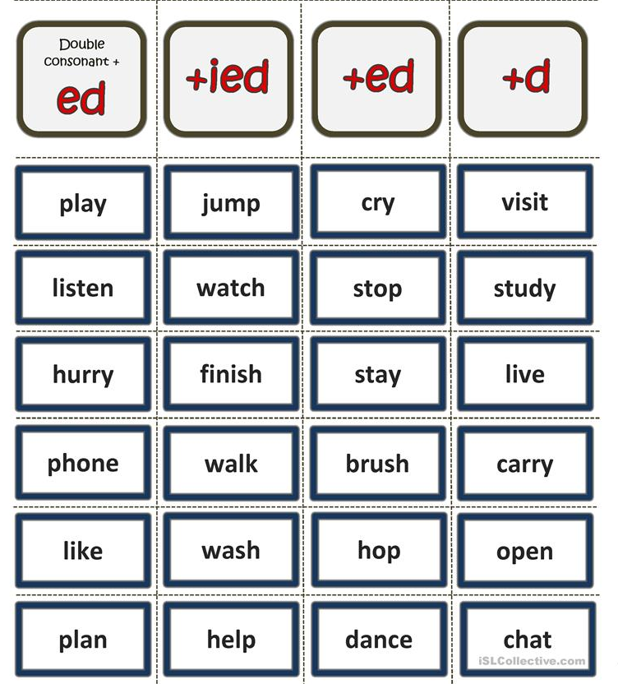
REGULAR VERBS
If a verb ends in “e”
🡪 add “-d”
like 🡪 liked
If a verb ends in a consonant + “y”
🡪 add “ied”
carry 🡪 carried
If a verb ends with a vowel + a consonant
🡪 (usually) double consonant + ed
plan 🡪 planned
Other cases
🡪 add “ed”
wash 🡪 washed

Slide 12
How to pronounce “ED"
/t/ | /d/ | /id/
vô thanh stopped, danced, walked, liked, finished,... | hữu thanh played, listened, phoned, lived, cried, planned,... | t, d visited, wanted, decided, needed,...

Slide 13
Irregular verbs
Irregular verbs | Simple past tense | Irregular verbs | Simple past tense
break bring buy catch come do fall | broke brought bought caught came did fell | ring run see sell sleep speak write | rang ran saw sold slept spoke wrote

Slide 14
Words
Phrases
HELPFUL HINTS
The past simple tense is often used with:
Yesterday
Last night/week/month/year
An hour/a week ago
In 2010

Slide 15
Put the verbs in the correct past simple form.
I ___________ (1 - go) on a walking holiday last summer. I mostly ___________ (2 - go) on foot, but sometimes ___________ (3 - catch) a bus when I ___________ (4 - be) tired. I ___________ (5 - see) a lot of beautiful sceneries on my journey, and I ___________ (6 - try) some local dishes, but they ___________ (7 - be) not to my taste (không hợp khẩu vị của tôi). On the trip, I ___________ (8 - not bring) my umbrella because I ___________ (9 - not pack) it, but a kind traveller ___________ (10 - give) me his umbrella, so I ___________ (11 - not get) wet when it ___________ (12 - rain). I ___________ (13 - plan) to stay there for 5 days, but in the end, I ___________ (14 - stay) for 7 days. Overall, I ___________ (15 - have) a great time, and I ___________ (16 - enjoy) the experience.
went
went
caught
was
saw
tried
were
didn’t bring
didn’t pack
gave
didn’t get
rained
planned
stayed
had
enjoyed

Slide 16
My trip last summer:
Last summer, I went to ….. with …..
We went there by …..
We stayed at a …
We visited some famous tourist attractions like ….
We tried some local dishes such as ……, and they tasted good. (but they were not to my taste.)
We stayed there for …. days, and we had a really great time together.

Slide 17
PAST CONTINUOUS

Slide 18
PAST CONTINUOUS
USAGE
EXAMPLE
Describe parallel actions
Last night, while I was washing the dishes, my sister was taking a shower.
Describe what someone was doing at a particular point in time
I was working in the garden at 7 am yesterday.
Express interrupted action in the past
We were having dinner when he came home.

Slide 19

PAST CONTINUOUS TENSE
S + was/were + V-ing + …
She was cooking all morning.
－
S + was/were + not + V-ing + …
She wasn’t sleeping when he came home.
Was/Were + S + V-ing + …?
Was she sleeping when he came home?

Slide 20
Words
Phrases
HELPFUL HINTS
The past continuous tense is often used with:
While
When
At that moment
At one/two o’clock

Slide 21
PRACTICE

Slide 22
Choose the correct tense of the verbs:
Last December, we (visited / were visiting) Sapa for the first time. It (snowed / was snowing) when we arrived, so the whole town looked beautiful and white.
While we (walked / were walking) through the village, we (saw / were seeing) children playing in the snow. My little sister (built / was building) a snowman while my parents (took / were taking) pictures of the mountains.
Suddenly, I (fell / was falling) because I (didn’t watch / wasn’t watching) where I was going. Luckily, I (didn’t hurt / wasn’t hurting) myself! Later that night, while we (ate / were eating) dinner, it (started / was starting) snowing again.
We (enjoyed / were enjoying) every moment of our trip. It was a holiday I’ll never forget.

Slide 23

GOODBYE
See you later!

